Slide 1
Clustering

Slide 2
Clustering
A way of grouping the data points into different clusters, consisting of similar data points. The objects with the possible similarities remain in a group that has less or no similarities with another group.
Cluster: A collection of data objects
  similar (or related) to one another within the same group
  dissimilar (or unrelated) to the objects in other groups
Cluster analysis (or clustering, data segmentation, …)
  Finding similarities between data according to the characteristics found in the data and grouping similar data objects into clusters

Slide 3
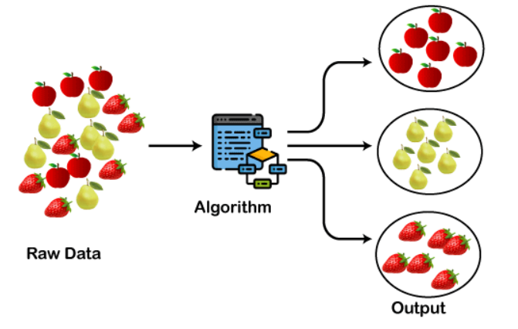
How the clustering Algorithm will works:

Slide 4
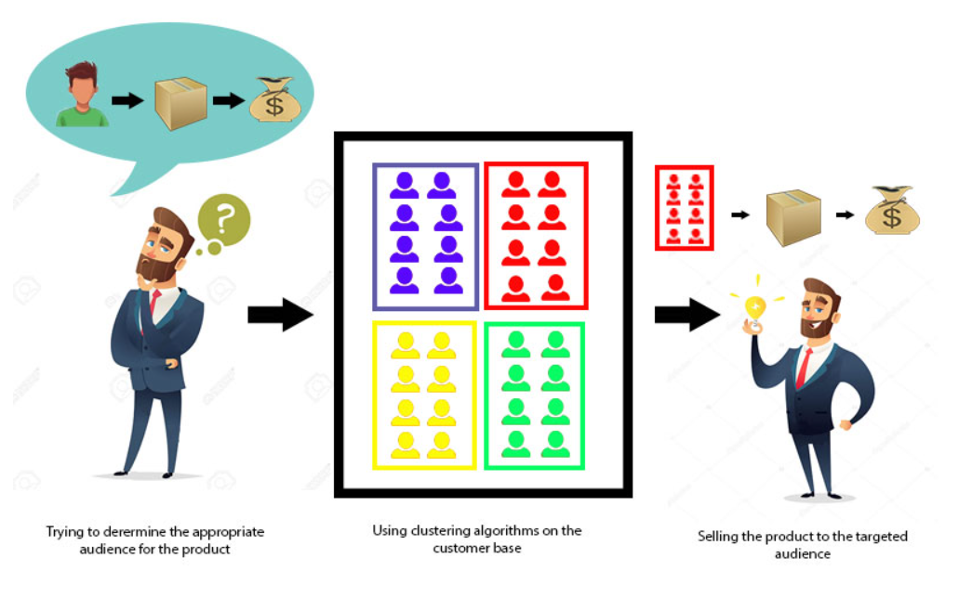
fig:The data from our customer base is divided into clusters, we can make an informed decision about who we think is best suited for this product.

Slide 5
Clustering for data understanding and Applications
Biology: taxonomy of living things: kingdom, phylum, class, order, family, genus and species
Information retrieval: document clustering
Land use: Identification of areas of similar land use in an earth observation database
Marketing: Help marketers discover distinct groups in their customer bases, and then use this knowledge to develop targeted marketing programs
City-planning: Identifying groups of houses according to their house type, value, and geographical location
Earth-quake studies: Observed earth quake epicenters should be clustered along continent faults
Climate: understanding earth climate, find patterns of atmospheric and ocean
Economic Science: market research.

Slide 6
Applications
Market Segmentation
Statistical data analysis
Social network analysis
Image segmentation
Anomaly detection, etc

Slide 7
Quality: What Is Good Clustering
A good clustering method will produce high quality clusters
high intra-class similarity: cohesive within clusters
low inter-class similarity: distinctive between clusters
The quality of a clustering method depends on
  the similarity measure used by the method
  its implementation, and
  Its ability to discover some or all of the hidden patterns

Slide 8
Major Clustering Approaches
Partitioning approach:
  Construct various partitions and then evaluate them by some criterion, e.g., minimizing the sum of square errors
  Typical methods: k-means, k-medoids, CLARANS
Hierarchical approach:
  Create a hierarchical decomposition of the set of data (or objects) using some criterion
  Typical methods: Diana, Agnes, BIRCH, CAMELEON
Density-based approach:
  Based on connectivity and density functions
  Typical methods: DBSACN, OPTICS, DenClue

Slide 9
Grid-based approach:
  based on a multiple-level granularity structure
  Typical methods: STING, WaveCluster, CLIQUE
Model-based:
  A model is hypothesized for each of the clusters and tries to find the best fit of that model to each other
  Typical methods: EM, SOM, COBWEB
Frequent pattern-based:
  Based on the analysis of frequent patterns
  Typical methods: p-Cluster

Slide 10
User-guided or constraint-based:
  Clustering by considering user-specified or application-specific constraints
  Typical methods: COD (obstacles), constrained clustering
Link-based clustering:
  Objects are often linked together in various ways
  Massive links can be used to cluster objects: SimRank, LinkClus

Slide 11
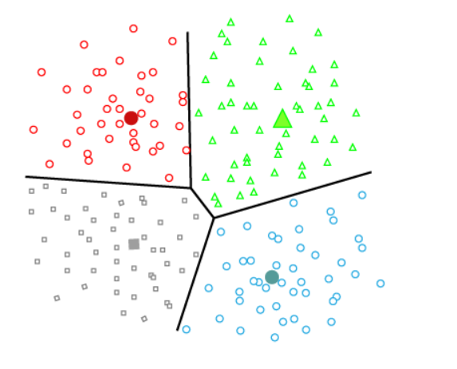
Partitioning Clustering

Slide 12
Introduction
It divides the data into non-hierarchical groups.
It is also known as the centroid-based method.
The most common example of partitioning clustering is the K-Means Clustering algorithm.
In this type, the dataset is divided into a set of k groups, where K is used to define the number of pre-defined groups.
The cluster center is created in such a way that the distance between the data points of one cluster is minimum as compared to another cluster centroid.

Slide 13
Partitioning a database D of n objects into a set of k clusters, such that the sum of squared distances is minimized (where ci is the centroid or medoid of cluster Ci.
Given k, find a partition of k clusters that optimizes the chosen partitioning criterion
Global optimal: exhaustively enumerate all partitions
Heuristic methods: k-means and k-medoids algorithms
k-means (MacQueen’67, Lloyd’57/’82): Each cluster is represented by the center of the cluster
k-medoids or PAM (Partition around medoids) (Kaufman & Rousseeuw’87): Each cluster is represented by one of the objects in the cluster

Slide 14
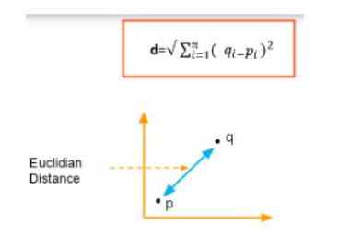
Distance between datapoints
We assume that each data point is a n-dimensional vector
K-Means clustering supports various kinds of distance measures, such as:
        Euclidean distance measure
        Manhattan distance measure
Euclidean Distance Measure
If we have a point P and point Q, the Euclidean
distance is an ordinary straight line.

Slide 15
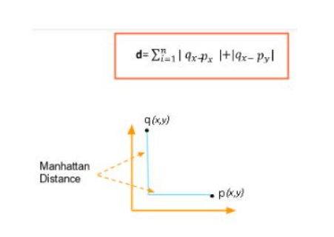
Manhattan Distance Measure
The Manhattan distance is the simple sum of the horizontal and vertical components or the distance between two points measured along axes at right angles.

Slide 16
The K-Means Clustering Method
Given k, the k-means algorithm is implemented in four steps:
Partition objects into k nonempty subsets
Compute seed points as the centroids of the clusters of the current partitioning (the centroid is the center, i.e., mean point, of the cluster)
Assign each object to the cluster with the nearest seed point
Go back to Step 2, stop when the assignment does not change

Slide 17
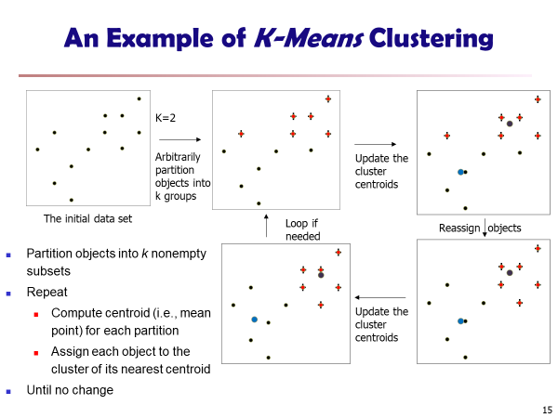

Slide 18
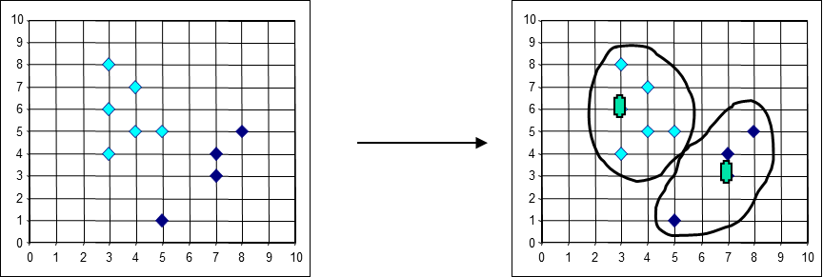

Slide 19
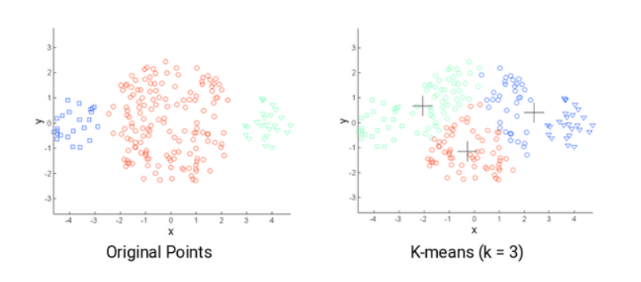
Challenges with the k-means clustering
Finding the optimal k value, especially for noisy data. The appropriate value of k depends on the data structure and the problem being solved. It is important to choose the right value of k, as a small value can result in under-clustered data, and a large value can cause over-clustering.
The size of clusters is different.

Slide 20
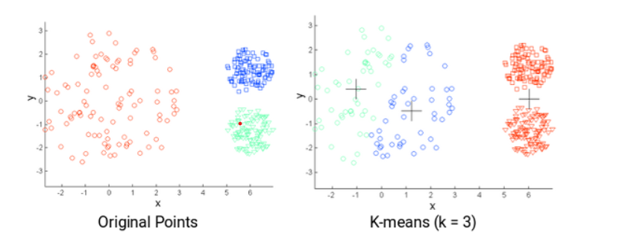
The densities of the original points are different.

Slide 21
Question
Use K-means clustering algorithm to decide the following data into two clusters.
Step 1: Choose randomly two clusters:
        V1=(2,1) and v2=(2,3)
x1 | 1 | 2 | 2 | 3 | 4 | 5
x2 | 1 | 1 | 3 | 2 | 3 | 5

Slide 22
Step 2: Find the distance between the cluster center’s and each data points.
Datapoint | Distance from v1 | Distance from v2 | Assigned center
a1(1,1) | 1 | 2.24 | V1
a2(2,1) | 0 | 2 | V1
a3(2,3) | 2 | 0 | V2
a4(3,2) | 1.4 | 1.4 | V1
a5(4,3) | 2.83 | 2 | V2
a6(5,5) | 5 | 3.61 | v2

Slide 23
Step 3: Assign each datapoint to clusters
cluster of v1 ={a1,a2,a4}
cluster of v2 = {a3,a5,a6}
Step 4: Recalculate the cluster center’s
v1=[a1+a2+a4]/3
= (2,1.33)
v2=[a3+a5+a6]/3
= (3.67,3.67)

Slide 24
Step 5: Repeat from step 2 until we get same cluster center or same cluster elements as in the previous iteration
datapoint | Distance from v1 | Distance from v2 | Assigned center
a1(1,1) | 1.05 | 3.78 | v1
a2(2,1) | 0.33 | 3.15 | v1
a3(2,3) | 1.67 | 1.8 | v1
a4(3,2) | 1.204 | 1.8 | v1
a5(4,3) | 2.605 | 0.75 | v2
a6(5,5) | 4.74 | 1.88 | v2

Slide 25
Cluster 1 of v1 ={a1,a2,a3,a4}
Cluster 2 of v2={a5,a6}
Recalculate the cluster centers:
v1= (2,1.75)
v2=(4.5,4)

Slide 26
Final clusters:
datapoint | Distance from v1 | Distance from v2 | Assigned center
a1(1,1) | 1.25 | 4.61 | v1
a2(2,1) | 0.75 | 3.9 | v1
a3(2,3) | 1.25 | 2.69 | v1
a4(3,2) | 1.03 | 2.5 | v1
a5(4,3) | 2.36 | 1.12 | v2
a6(5,5) | 4.42 | 1.12 | v2

Slide 27
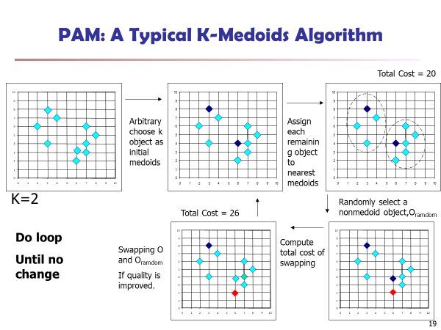

Slide 28
K-Medoids Clustering
K-Medoids Clustering: Find representative objects (medoids) in clusters
PAM (Partitioning Around Medoids, Kaufmann & Rousseeuw 1987)
  Starts from an initial set of medoids and iteratively replaces one of the medoids by one of the non-medoids if it improves the total distance of the resulting clustering
  PAM works effectively for small data sets, but does not scale well for large data sets (due to the computational complexity)

Slide 29
K-Medoids:
Choose k number of random points from the data and assign these k points to k number of clusters. These are the initial medoids.
For all the remaining data points, calculate the distance from each medoid and assign it to the cluster with the nearest medoid.
Calculate the total cost (Sum of all the distances from all the data points to the medoids)
Select a random point as the new medoid and swap it with the previous medoid. Repeat 2 and 3 steps.
If the total cost of the new medoid is less than that of the previous medoid, make the new medoid permanent and repeat step 4.
If the total cost of the new medoid is greater than the cost of the previous medoid, undo the swap and repeat step 4.
The Repetitions have to continue until no change is encountered with new medoids to classify data points.

Slide 30
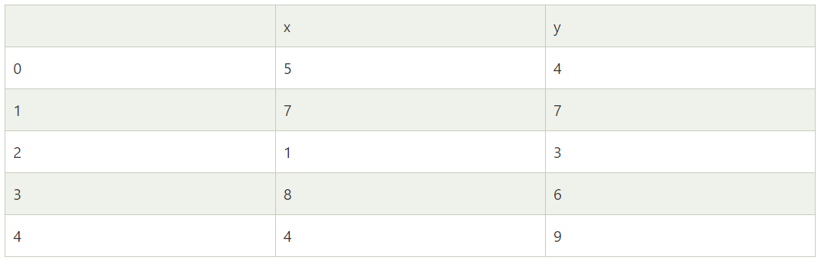
example

Slide 31
K=2
Initial medoids: M1(1, 3) and M2(4, 9)
Calculation of distances

Slide 32
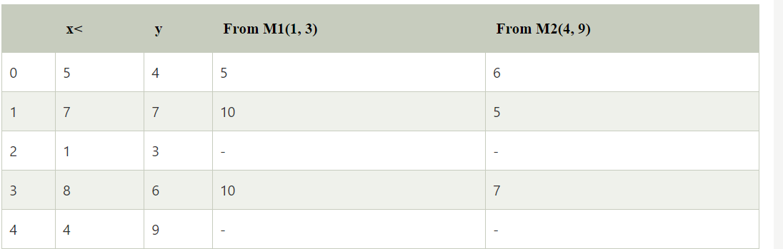
Calculation of distance:
Cluster 1: 0
Cluster 2: 1, 3

Slide 33
Calculation of total cost:
(5) + (5 + 7) = 17
Random medoid: (5, 4)

Slide 34
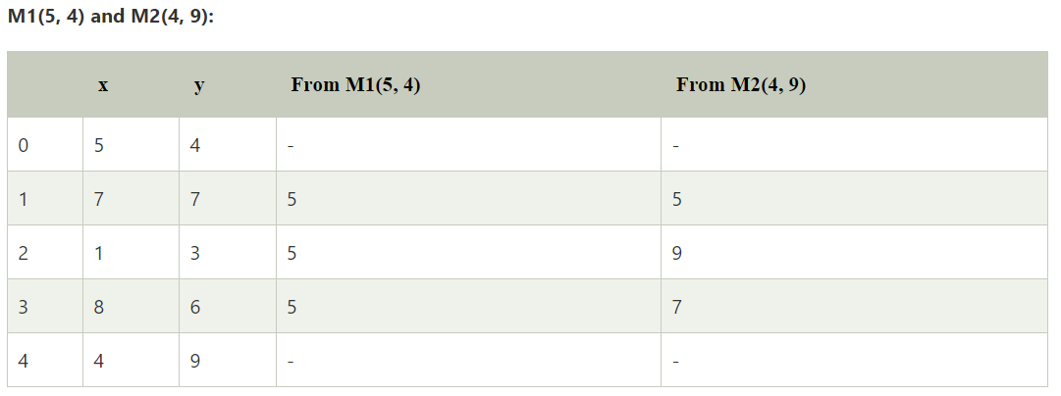
Cluster 1: 2, 3
Cluster 2:1

Slide 35
Calculation of total cost:
(5 + 5) + 5 = 15
Less than the previous cost
New medoid: (5, 4).
Random medoid: (7, 7)

Slide 36
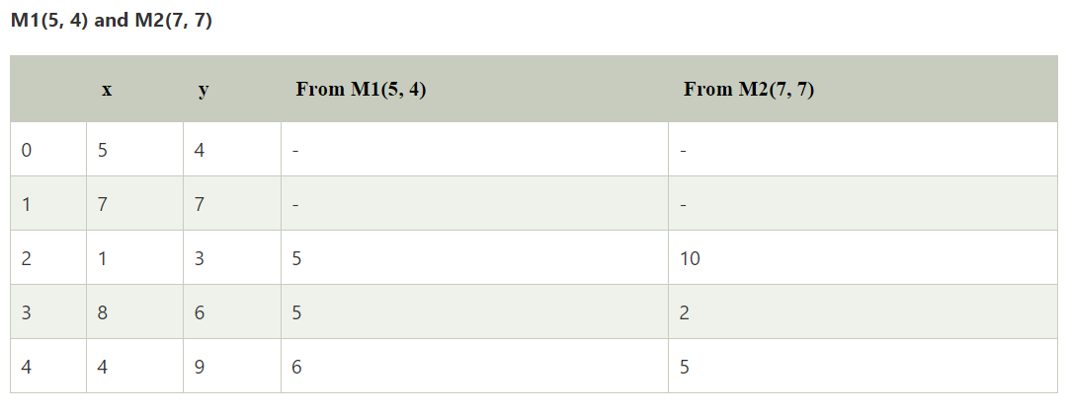

Slide 37
Cluster 1: 2
Cluster 2: 3, 4
Calculation of total cost:
(5) + (2 + 5) = 12
Less than the previous cost
New medoid: (7, 7).
Random medoid: (8, 6)

Slide 38
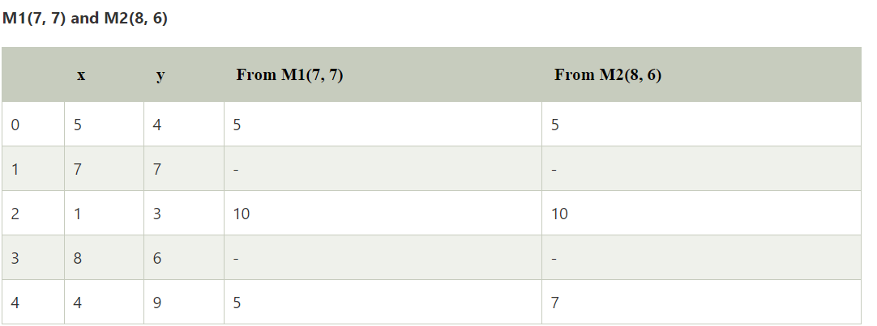

Slide 39
Cluster 1: 4
Cluster 2: 0, 2
Calculation of total cost: (5) + (5 + 10) = 20
Greater than the previous cost
UNDO : Hence, the final medoids: M1(5, 4) and M2(7, 7)
Cluster 1: 2
Cluster 2: 3, 4
Total cost: 12

Slide 40
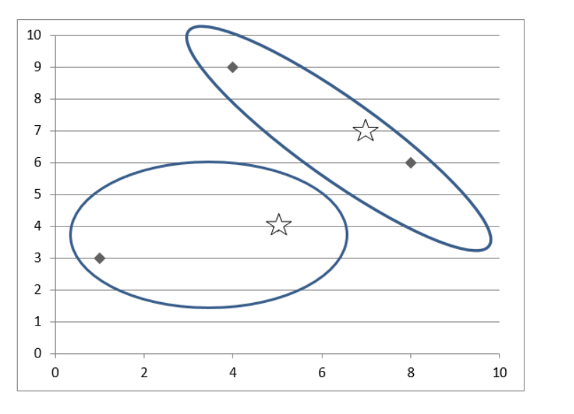
Final results

